Slide 1
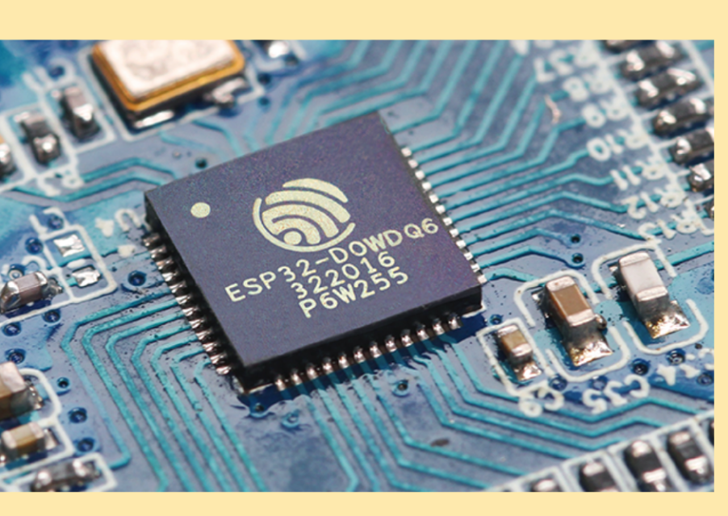

ESP 32 Architecture
Akbar Q

Slide 2

What Do You Mean by Architecture?

Slide 3

Definition: Architecture refers to the structure and design of a system's internal components
Including parts such as the:
CPU
Memory
Peripherals
Communication Interfaces

Slide 4
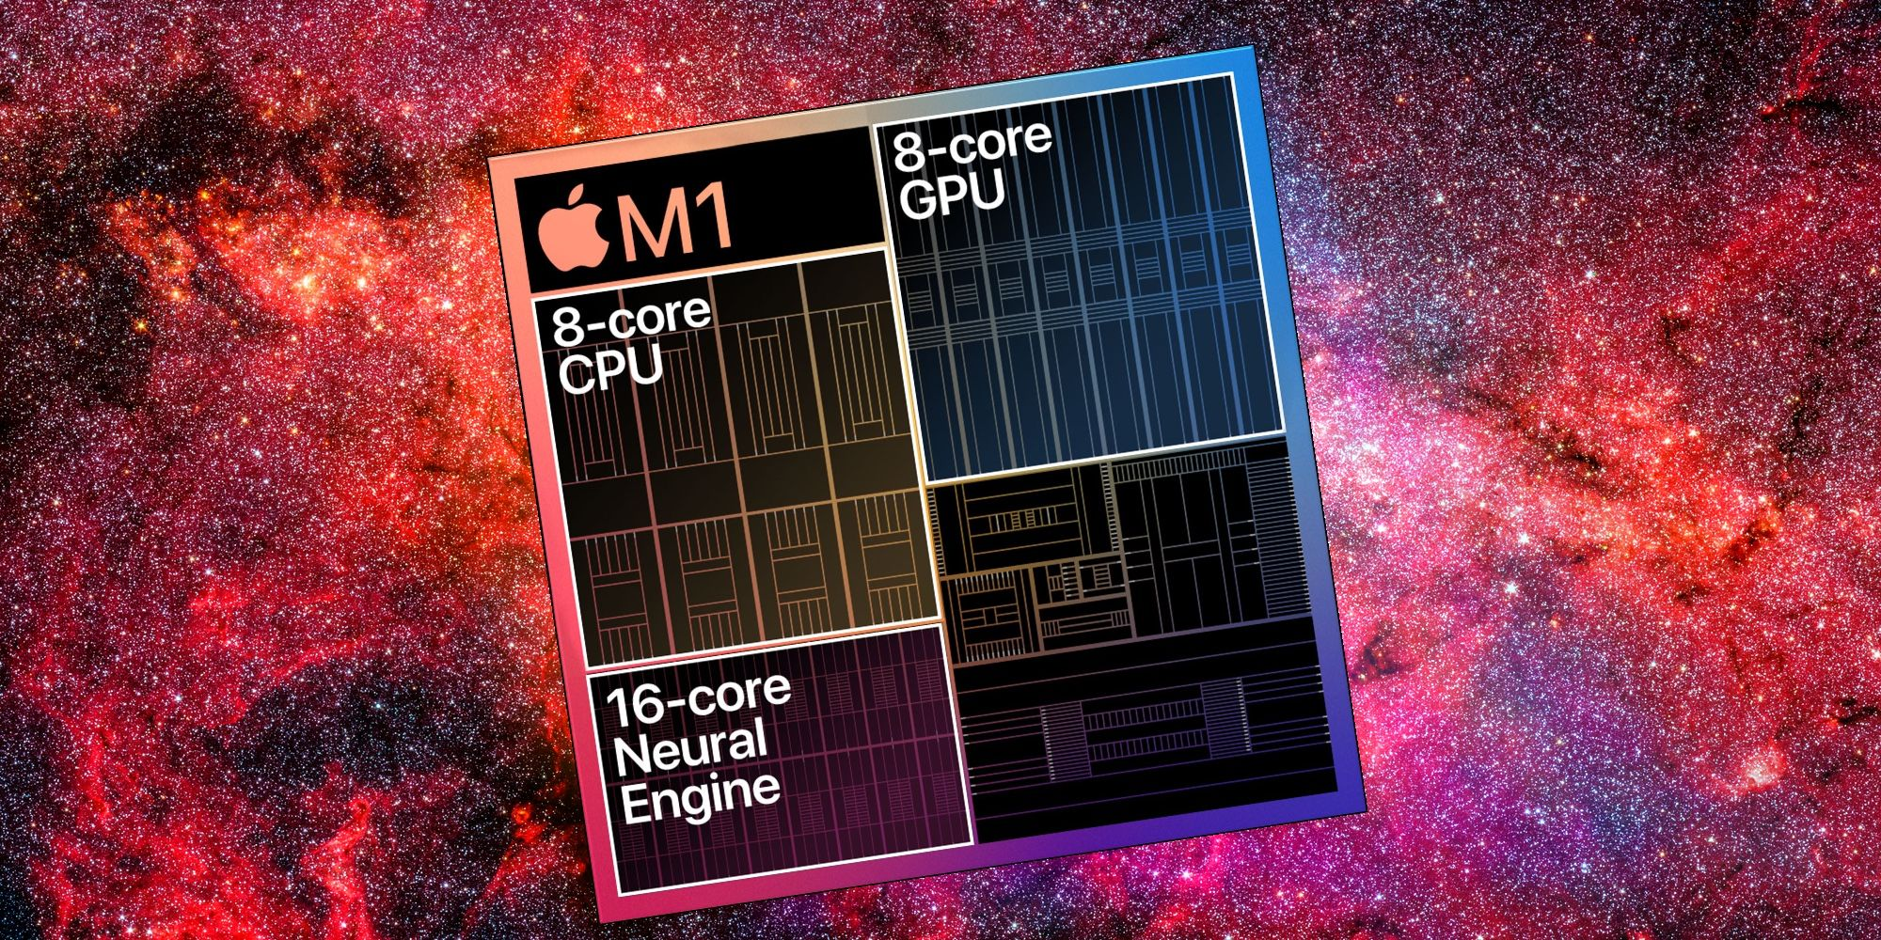

Slide 5

Scan For Module Data Sheet

Slide 6

Scan For SoC Data Sheet

Slide 7
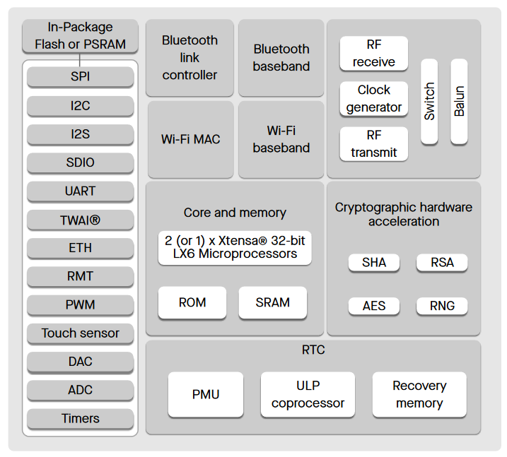
The Block
Diagram
It is Very
Comprehensive

Slide 8
The Block
Diagram
Starting with
The CORE

Slide 9

What Does it Mean by Xtensa 32 Bit LX6 Microprocessors?
Tensilica Inc. was a company based in Silicon Valley in the semiconductor intellectual property core business. It is now a part of Cadence Design Systems. Tensilica offers customizable Xtensa microprocessor cores

Slide 10

What Does it Mean by Xtensa 32 Bit LX6 Microprocessors?
The number of bits (e.g., 8-bit, 16-bit, 32-bit, 64-bit) indicates how many bits of data the processor can process at once.
A 32-bit processor can handle 32 bits (4 bytes) of data in one operation, while a 64-bit processor can handle 64 bits (8 bytes).

Slide 11



Slide 12

Find Out The 3 Most Prominent Architectures

Slide 13
The 3 Most Prominent Architectures x86 ARM RISC-V

Slide 14






Who Else Exists?
Here are Some Juggernauts

Slide 15
ROM (Read-Only Memory)
Function: Stores permanent data that does not change, like the firmware or bootloader.
Characteristics: Non-volatile memory, meaning it retains data even when power is turned off.
Usage: Used for critical system instructions that are required at startup and don’t need modification.
Example: In the ESP32, ROM stores the bootloader, Serial Number, Config info which helps initialize the system.

Slide 16
ROM is NOT STORAGE
Soo Many People Get This Wrong Because of
Outdated Over-Simplifications

Slide 17
Feature | ROM (Read-Only Memory) | Flash Memory
Purpose | Stores permanent, system-level instructions (e.g., bootloader) | Stores user programs, firmware, and data
Modifiability | Not easily modifiable (written during manufacturing) | Reprogrammable and erasable
Usage | Used for essential startup and low-level system functions | Used for firmware updates and storing applications
Size | Small (just enough for system instructions) | Larger (typically 4 MB or more in ESP32)
Volatility | Non-volatile (retains data when power is off) | Non-volatile (retains data when power is off)
Rewritability | Cannot be rewritten or updated frequently | Can be rewritten and updated multiple times
Example in ESP32 | Stores bootloader and essential startup code | Stores the user-uploaded program and firmware
Main Function | Provides the initial instructions for booting | Acts as general-purpose storage for programs and data

Slide 18
SRAM (Static Random-Access Memory)
Function: Used for temporary data storage during program execution, like variables or program instructions in use.
Characteristics: Volatile memory, meaning it loses data when power is turned off. Faster and requires more power compared to DRAM.
Usage: Used as working memory (for stack, cache, etc.) to quickly store and access data while the processor is running.
Example: In the ESP32, SRAM is used to store active program data while the processor operates.

Slide 19


Slide 20
Flash Storage
Non-Volatile:
Flash storage retains data even when the power is turned off, unlike SRAM or DRAM. This makes it suitable for storing the programs, firmware, and data that need to persist even after the device is powered down.
Rewritable and Erasable:
Unlike ROM, flash memory can be erased and reprogrammed. This allows for updates, such as flashing new firmware or modifying user applications.
Flash memory is divided into blocks, and you can erase and rewrite data block by block, making it more flexible for embedded applications.
Program Storage:
On the ESP32, flash storage holds the firmware and user programs. When you write code and upload it to the ESP32 (e.g., through the Arduino IDE or PlatformIO), the code is stored in flash memory, ensuring the ESP32 can run your program after reboot.

Slide 21
Capacity:
Flash storage on the ESP32 typically ranges from 4 MB to 16 MB, which provides enough space to store multiple programs, configurations, and data logs.
Slower Access Compared to RAM:
While flash is non-volatile and versatile, it is slower to access than SRAM. Therefore, active data (like variables or real-time processing instructions) are usually stored in SRAM, while static program data resides in flash.
Write Limitations:
Flash storage has a limited number of write/erase cycles (usually in the range of tens of thousands to a few hundred thousand cycles). This means while it’s suitable for program storage and infrequent data logging, it’s not ideal for tasks requiring frequent updates.
A Note-Worthy Type of Memory:
NAND Flash: Offers larger storage capacity, slower read speeds, and is often used for mass storage devices like USB drives. The ESP32 typically uses NAND flash for program and data storage.

Slide 22
The Block
Diagram
The Return

Slide 23
The Block
Diagram
Just Scratched
The Surface

Slide 24
The Block
Diagram
Just Scratched
The Surface

Slide 25
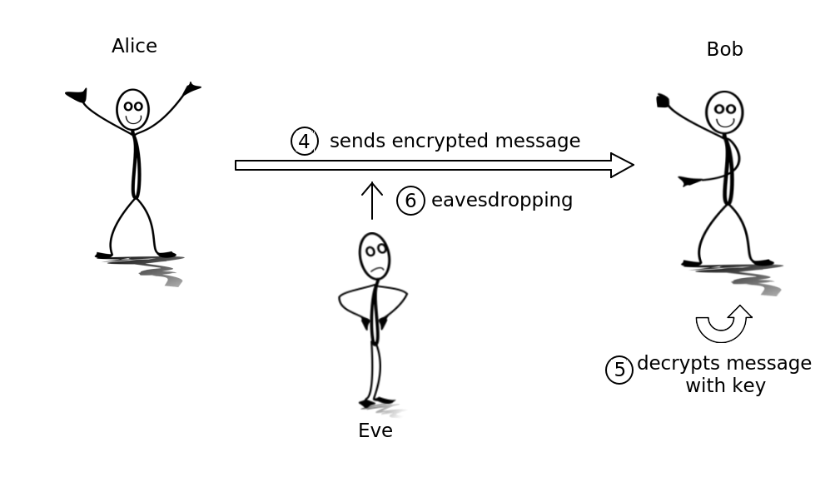

Slide 26
Cryptography – Preventing Man in the Middle
Definition: Cryptographic hardware is dedicated silicon within a microcontroller, like the ESP32, that handles encryption, decryption, and key management efficiently and securely.
Purpose: Instead of relying on software, the cryptographic operations (e.g., encryption algorithms) are performed directly in hardware. This is faster, more energy-efficient, and provides a higher level of security.
Energy efficiency: Dedicated hardware uses less power for encryption tasks compared to software-based solutions.
Security: Hardware-based cryptography makes sensitive operations like encryption, key generation, and authentication more resistant to attacks (like side-channel attacks).

Slide 27
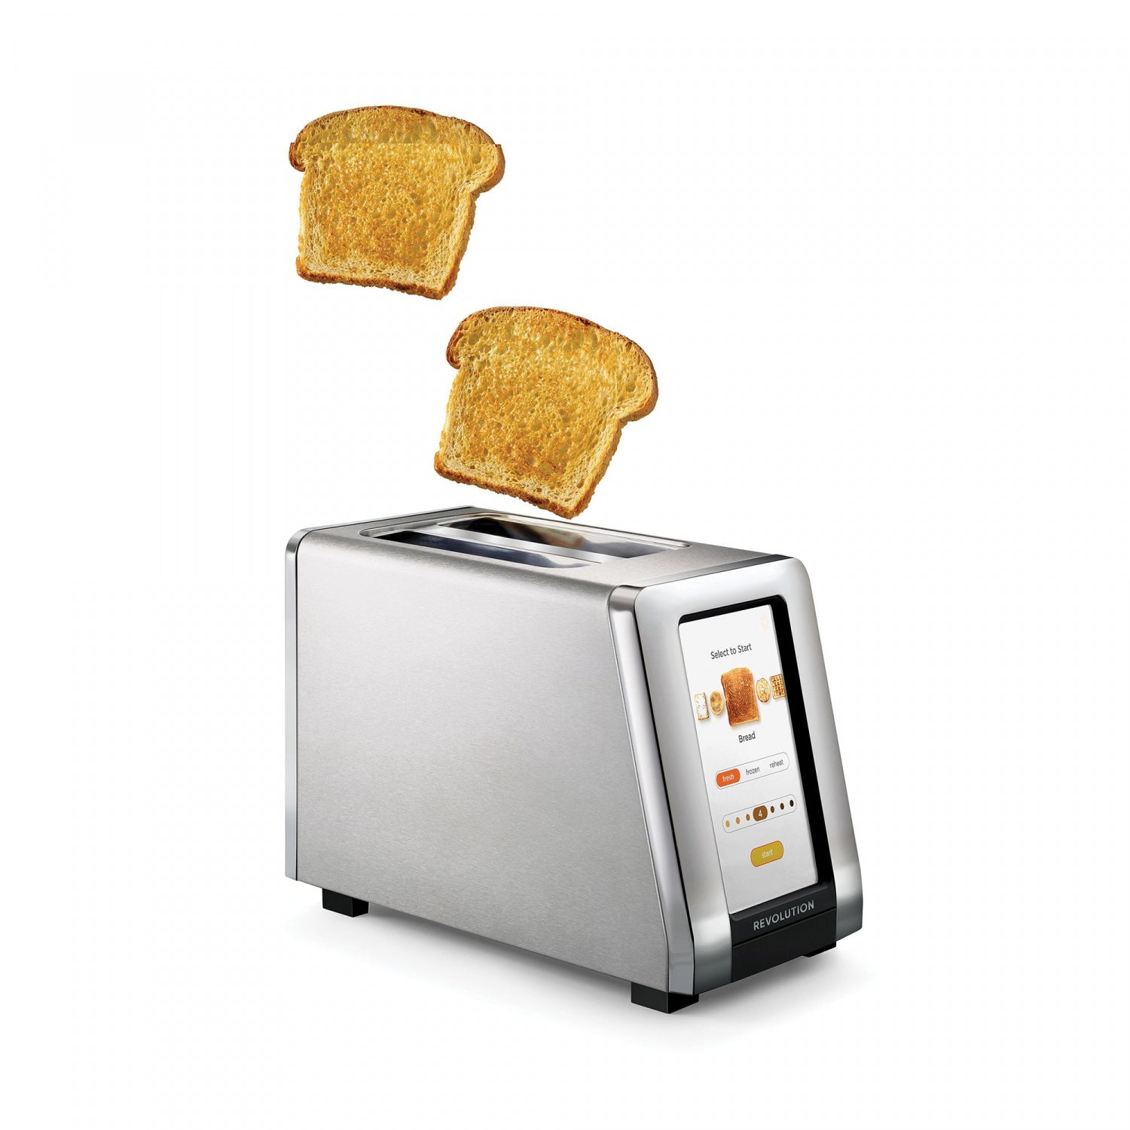
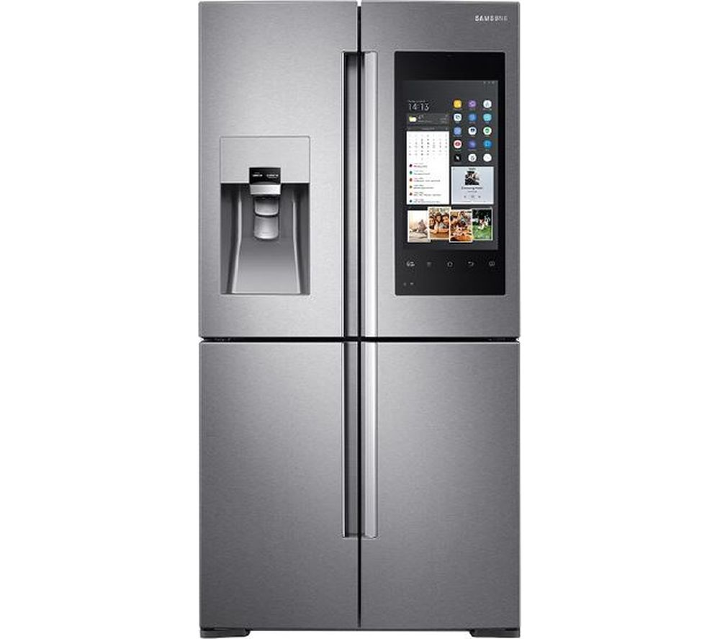
Do You Want Your Fridge to Run Away or Your Toaster to Serve You Burt Toast?

Slide 28

Yes, that’s the Dystopia We Live In

Slide 29
Why Does the ESP 32 Models Need it?
Secure Wireless Communication:
The ESP32 is often used in Wi-Fi and Bluetooth applications where secure communication is critical. By using cryptographic hardware to handle encryption (e.g., AES for Wi-Fi encryption), the ESP32 ensures that data transmitted wirelessly cannot be easily intercepted or tampered with.
Example: In Wi-Fi Protected Access (WPA2), the AES encryption used to secure the connection is processed by the cryptographic hardware, ensuring fast, secure transmission without bogging down the CPU.
Efficient IoT Security:
In Internet of Things (IoT) devices, secure communication between sensors, devices, and servers is essential to prevent unauthorized access. The ESP32’s cryptographic hardware accelerates operations like RSA (for secure key exchanges) and SHA (for message integrity), ensuring that devices communicate securely with minimal processing overhead.
Example: An ESP32-based smart device communicating with a cloud server can use RSA for exchanging encryption keys and AES to encrypt data sent back and forth, ensuring secure IoT connectivity.

Slide 30
SHA (Secure Hash Algorithm):
A family of cryptographic hash functions that convert data into a fixed-size hash. Commonly used in data integrity verification (e.g., SHA-256). Ensures data hasn't been altered in transmission by producing unique hash values for each data input.
RSA (Rivest-Shamir-Adleman):
An asymmetric encryption algorithm that uses a public/private key pair for secure data exchange. Secure communication by encrypting data with a public key, which can only be decrypted by the corresponding private key.
AES (Advanced Encryption Standard):
A symmetric encryption algorithm used for securing sensitive data. AES operates with fixed block sizes and key lengths (e.g., AES-128, AES-256). Widely used for data encryption in secure communication, Wi-Fi encryption, and data storage.
RNG (Random Number Generator):
Hardware RNG generates random numbers, critical for cryptographic processes like key generation. Ensures unpredictability in encryption keys and other cryptographic operations, which is vital for security.

Slide 31
The Block
Diagram
Just Scratched
The Surface

Slide 32
The Block
Diagram
Just Scratched
The Surface

Slide 33
The Block
Diagram
Just Scratched
The Surface

Slide 34
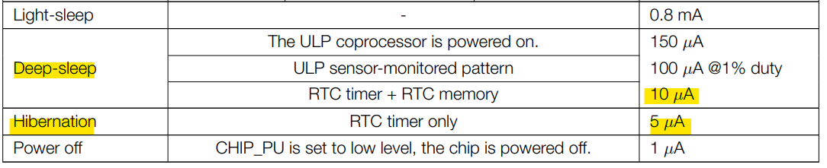
ESP 32 Power Modes
The ESP32 supports various power modes to optimize energy consumption based on the task at hand. These modes allow the device to balance performance with power efficiency

Slide 35
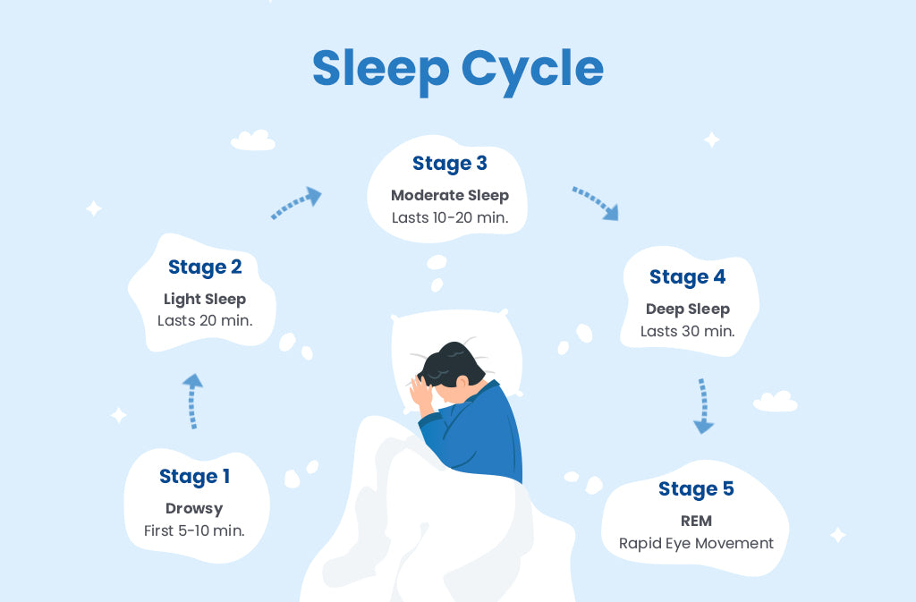

Slide 36
Active Mode (Running):
The CPU is fully operational, handling all tasks and processes at maximum performance.
Power consumption is highest in this mode.
Used when real-time tasks, high-speed data processing, or communication are required.
Modem Sleep Mode:
The Wi-Fi and Bluetooth modems are disabled while the CPU remains active or idle.
Reduces power consumption during communication idle periods, while still allowing the ESP32 to run other tasks.
Light Sleep Mode:
Most of the system clocks are powered down, and peripheral functions (such as GPIO or touch sensors) can wake the device.
The CPU and memory remain powered but are idle.
Significantly reduces power usage while allowing fast wake-up from external interrupts or timers.

Slide 37


Slide 38
Deep Sleep Mode:
CPU and most peripherals are powered off, leaving only the RTC and ULP coprocessor active.
Lowest power mode for long idle periods or battery-powered applications.
Can wake up based on a timer, external GPIO events, or data from sensors monitored by the ULP coprocessor.
Hibernation Mode:
Minimal functionality is retained, and the system is effectively shut down with only a small portion of the RTC memory and configuration preserved.
Lowest possible power consumption.
Suitable for applications where the device only needs to wake up after very long intervals.

Slide 39
Some Engineers like some ESP Applications Don’t Need to Sleep But the RTC Still Matters
When working with low-power devices like the ESP32, power failures and voltage drops can occur. Understanding how the ESP32 handles these situations is key for maintaining system stability:
Brown-Out Detection:
What It Is: A brown-out is a condition where the supply voltage drops below the minimum operating voltage required for the ESP32 to function correctly.
The ESP32’s brown-out detector triggers a system reset when the supply voltage dips too low, preventing unexpected behavior or data corruption.
Use: Prevents the ESP32 from running at unstable voltages, which could cause malfunctions or damage.

Slide 40
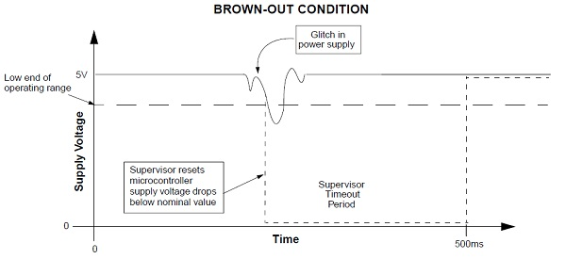

Slide 41
Helps with The Watchdog Timer Reset
What It Is: The WDT monitors whether the system is stuck or not responding, it resets the ESP32 if the software becomes unresponsive or enters an infinite loop, ensuring the system can recover from software faults.
Use: Helps in maintaining system reliability by automatically recovering from unexpected failures.

Slide 42
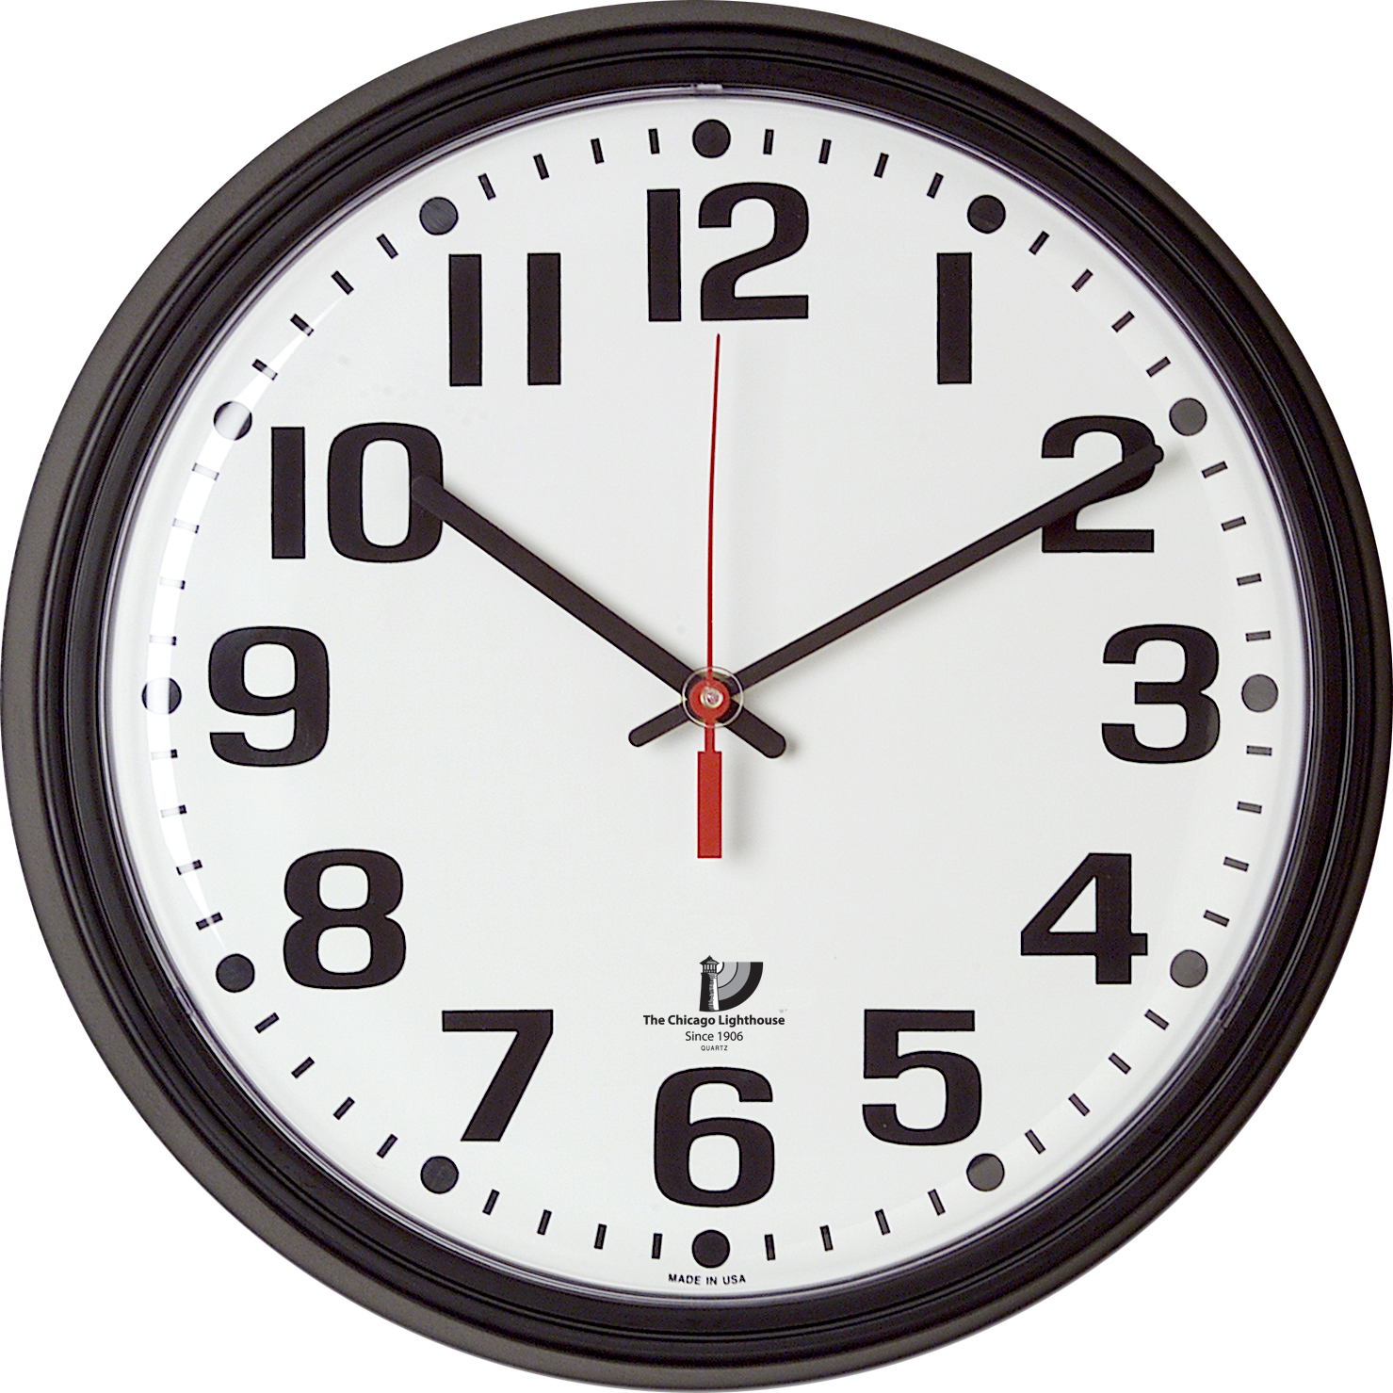
Coming back to the RTC Which Enables It
It is literally just a clock which the ESP has running all of the time.
It runs independent of the rest of the microcontroller rather than relying on the processor to handle counting.
Being separate allows it to run regardless of power state or processor lockup.
Can be external, battery powered

Slide 43
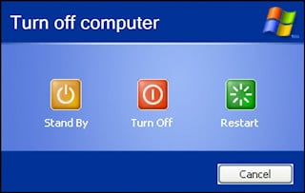
Power Management Unit (PMU)
What It Is: Controls the different power modes of the ESP32 (active, light sleep, deep sleep).
Use: Manages when to switch between low-power states and active states, optimizing battery life.
Example: The PMU puts the ESP32 into deep sleep when inactive and wakes it up when required by a timer or external event.

Slide 44

Ultra Low Power co-Processor (ULP)
What It Is: A small, energy-efficient processor that can operate while the main CPU is in deep sleep.
Use: Handles simple tasks like reading sensors, checking conditions, or managing wake-up signals without waking up the main CPU.
Example: The ULP can read data from a sensor every few seconds and only wake the main CPU if certain thresholds are met, reducing power consumption.

Slide 45

Recovery Mode
What It Is: A mode in which the ESP32 can return to a known state after a power failure or reset.
Use: Ensures the system can recover from unexpected power issues without losing critical data.
Example: After a power outage, the ESP32 can recover its state and continue from where it left off, reducing downtime and ensuring consistent operation.

Slide 46


Slide 47
The Block
Diagram
Just Scratched
The Surface

Slide 48
The Block
Diagram
Just Scratched
The Surface

Slide 49
The Block
Diagram
Just Scratched
The Surface

Slide 50

Find Out What Each is Used For in General

Slide 51
The Bluetooth Link Controller
The Bluetooth Link Controller (LC) is responsible for managing the low-level Bluetooth operations. It handles the link layer protocol and controls the physical transmission and reception of data.
Device Pairing and Connections: Manages Bluetooth connections, including device discovery, pairing, and establishing connections between Bluetooth devices.
Flow Control: Handles data flow control between devices, ensuring that data packets are transmitted and received efficiently.
Error Detection and Correction: Ensures data integrity through error detection and correction mechanisms during communication.

Slide 52
The Bluetooth Baseband
The Bluetooth Baseband layer handles the core Bluetooth operations related to the physical transmission of data packets. It works closely with the Link Controller to implement the basic transmission and reception protocols.
Packet Formation: The baseband layer is responsible for forming and parsing Bluetooth data packets before they are sent over the air or after they are received.
Frequency Hopping: Supports frequency hopping to avoid interference with other wireless signals. Bluetooth devices hop between frequencies, improving connection stability and security.
Synchronization: Ensures devices are properly synchronized for accurate timing of packet transmission and reception.

Slide 53
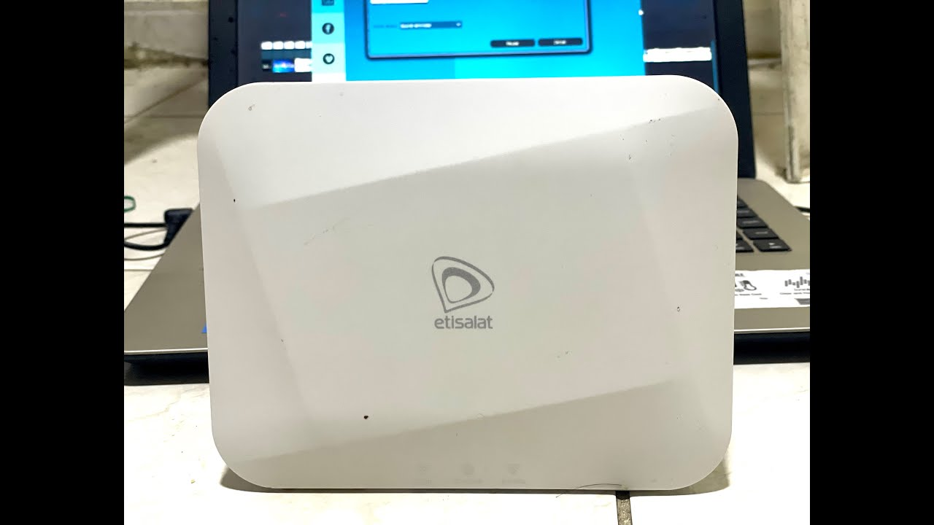

Slide 54
Wi-Fi MAC (Media Access Control)
The Wi-Fi MAC layer is responsible for controlling access to the wireless medium, managing the transmission and reception of data packets over Wi-Fi.
Frame Control: Handles the creation and management of Wi-Fi data frames, including addressing and sequencing of packets to ensure proper delivery.
Collision Avoidance: Implements collision avoidance mechanisms to prevent data packet collisions in shared wireless environments, improving transmission efficiency.
Power Management: The Wi-Fi MAC supports power-saving modes, allowing the ESP32 to conserve energy while maintaining its connection to Wi-Fi networks.

Slide 55
Wi-Fi Baseband
The Wi-Fi Baseband is responsible for the physical layer (PHY) operations of Wi-Fi communication, including signal modulation, demodulation, and encoding.
Modulation and Demodulation: Converts digital data into radio waves (modulation) and back into digital data (demodulation) to enable wireless communication over the air.
Error Correction: Implements error correction techniques to recover lost or corrupted data during transmission.
Signal Processing: Handles the signal processing needed to transmit data over Wi-Fi at different speeds, depending on the quality of the wireless channel.

Slide 56
The Block
Diagram
Just Scratched
The Surface

Slide 57
The Block
Diagram
Just Scratched
The Surface

Slide 58
The Block
Diagram
Just Scratched
The Surface

Slide 59
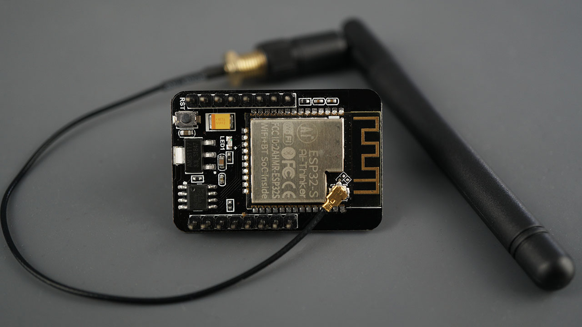

Slide 60
RF Transmit / Receive
The RF (Radio Frequency) Transmit/Receive section handles the conversion of digital signals into radio waves for wireless transmission and vice versa for reception. It handles both Wi-Fi and Bluetooth which Operate in the same 2.4GHz Band
Transmission (Tx):Converts digital signals into analog radio frequency signals that can be transmitted over Wi-Fi, Bluetooth, or other wireless protocols. Amplifies the signal to ensure it can travel over distances.
Reception (Rx):Captures incoming radio waves and converts them back into digital data that the system can process. Includes filtering and amplification to improve signal quality and reduce noise.

Slide 61
HF Clock Generator
Produces the high-frequency clock signals needed for RF mixing. In the ESP32, these signals are used to upconvert digital baseband signals to radio frequencies for transmission and downconvert incoming RF signals back to baseband for processing.
RF Mixing is a process where signals are combined with a high-frequency signal (generated by the Clock Generator) to either shift them up to a higher frequency (for transmission) or down to baseband (for reception). This is essential for Wi-Fi and Bluetooth communication, which operate at specific radio frequencies.
The Reference Clock Provides a stable and accurate reference frequency to ensure precise modulation, demodulation, and synchronization during RF communication.

Slide 62
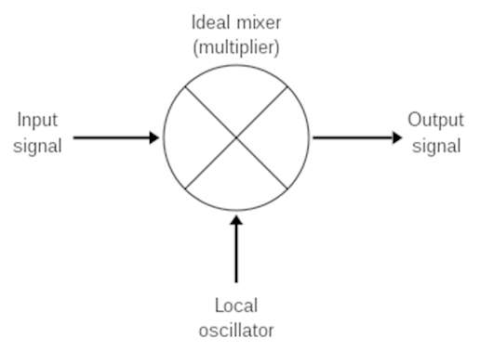
Beacause Wi-Fi/BT is 2.4GHz NOT 200MHz

Slide 63
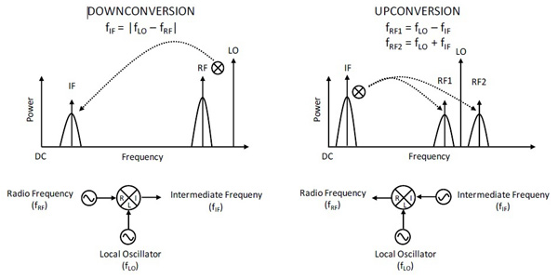

Slide 64
RF Switching
Directs the signal either to the transmitter or the receiver, ensuring the right path for data communication
Helps in matching impedance between different components, minimizing signal loss and improving overall performance.
The RF Switch is crucial for efficient communication, ensuring smooth transitions between transmitting and receiving modes without interference.
During Wi-Fi communication, the RF Switch ensures the ESP32 can quickly switch between sending data (Tx) and receiving data (Rx) as needed

Slide 65
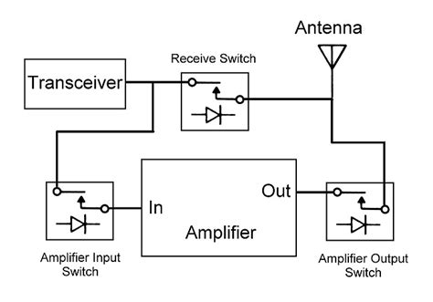

Slide 66
The BALUN
A Balun is a transformer that converts a balanced signal (with equal and opposite voltages) to an unbalanced signal (with one side grounded) and vice versa.
Helps maximize the efficiency of signal transmission and reception by reducing reflection and power loss.
The Balun ensures efficient transmission of RF signals to and from the antenna, improving signal quality and reducing interference.

Slide 67
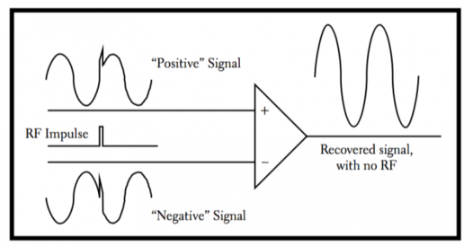
Why Generate Balanced Signals?

Slide 68
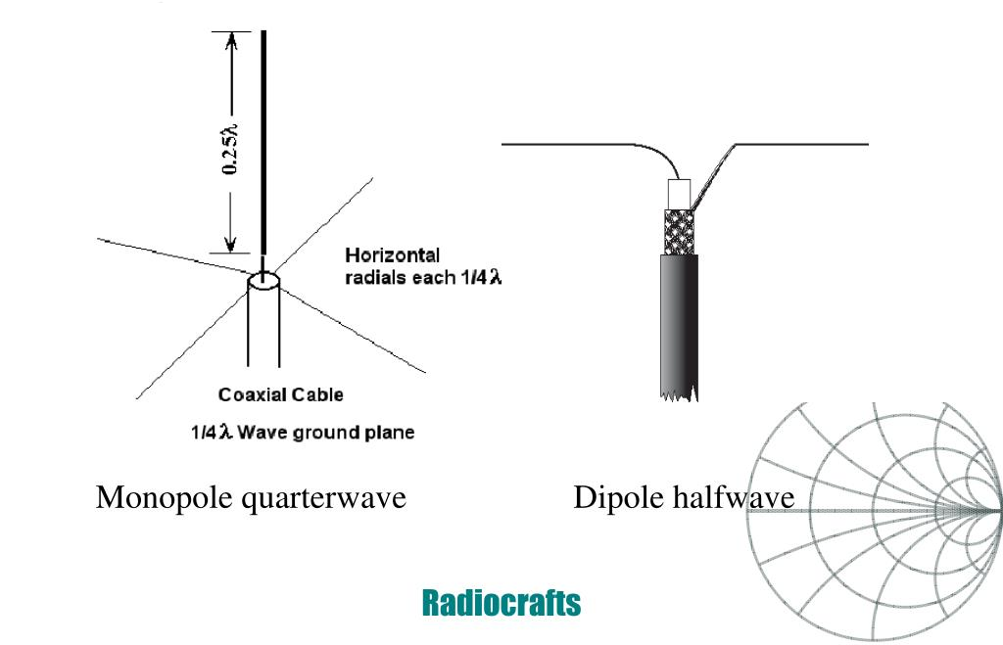
Most Power Analog Outputs are Balanced
Antennas Can Also come in Monopole and Dipole Configurations

Slide 69
The Block
Diagram
Just Scratched
The Surface

Slide 70
The Block
Diagram
Just Scratched
The Surface

Slide 71
Communication Interfaces
Hardware-based peripherals provide much faster and more reliable communication than software-only solutions. Direct access to hardware eliminates delays caused by software processing, leading to higher data throughput and reduced latency.
Are more energy-efficient, as they are optimized to perform specific tasks without burdening the main processor, which can conserve power, especially in low-power devices like the ESP32.
Can handle tasks independently of the main CPU, allowing the processor to focus on other computations while the hardware handles communication or data transfer.
Many applications, such as sensor reading or communication protocols, require real-time data processing that software-based solutions cannot guarantee due to their inherent delays and processing overhead.

Slide 72

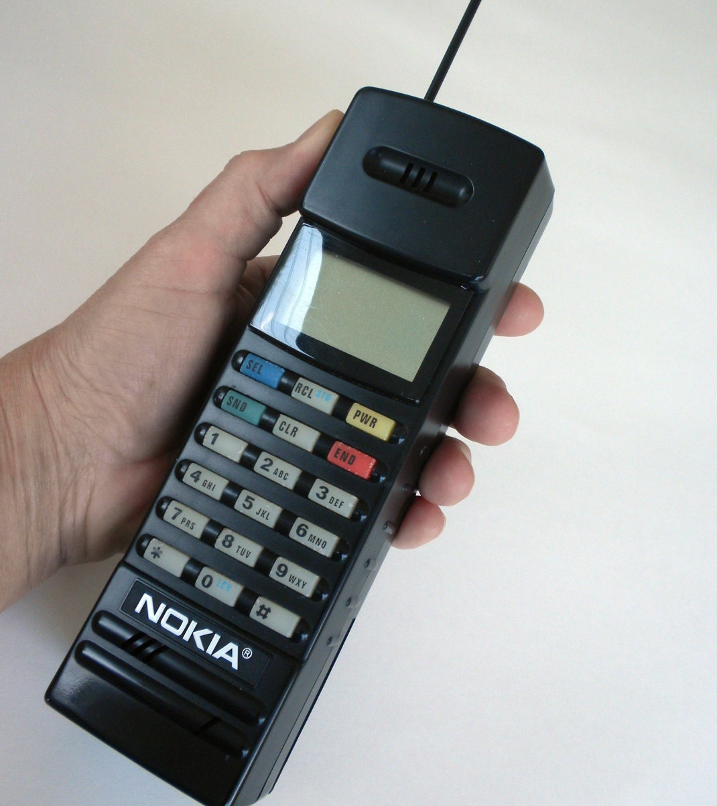
What is This?

Slide 73
Serial Peripheral Interface
The SPI is a high-speed synchronous communication protocol used for short-distance communication between the ESP32 and external devices like sensors, displays, or storage.
Synchronous Communication: Uses a shared clock signal for precise data transfer.
Full-Duplex: Supports data simultaneously in both directions.
Master/Slave Architecture: Allows multiple devices to communicate with the ESP32 in master/slave mode.

Slide 74
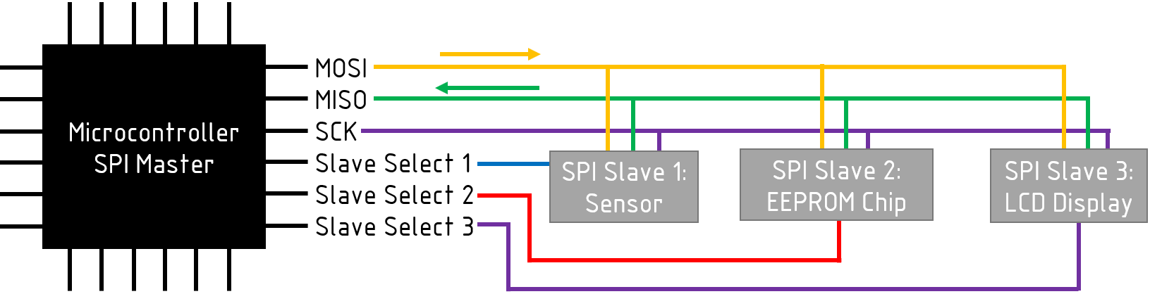
Master Slave Arrangement Serial Input – Serial Output – Serial Clock Select Pins

Slide 75
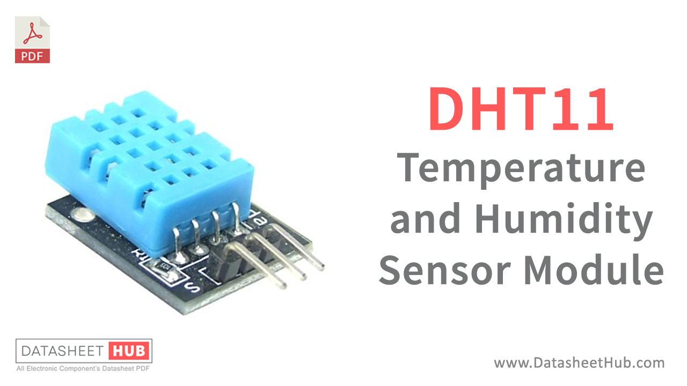
The common DHT Series Sensors Use SPI

Slide 76
Inter-Integrated Circuit
I2C is a multi-master, multi-slave communication protocol designed for short-distance data transfer between the ESP32 and peripherals like sensors or EEPROMs.
Requires only two wires (SDA - data, SCL - clock) for communication.
Each device connected to the bus has a unique address for identification.
Typically used for connecting low-speed sensors, real-time clocks, and other peripherals that don’t require fast data transfer rates but need simple, low-pin-count communication

Slide 77
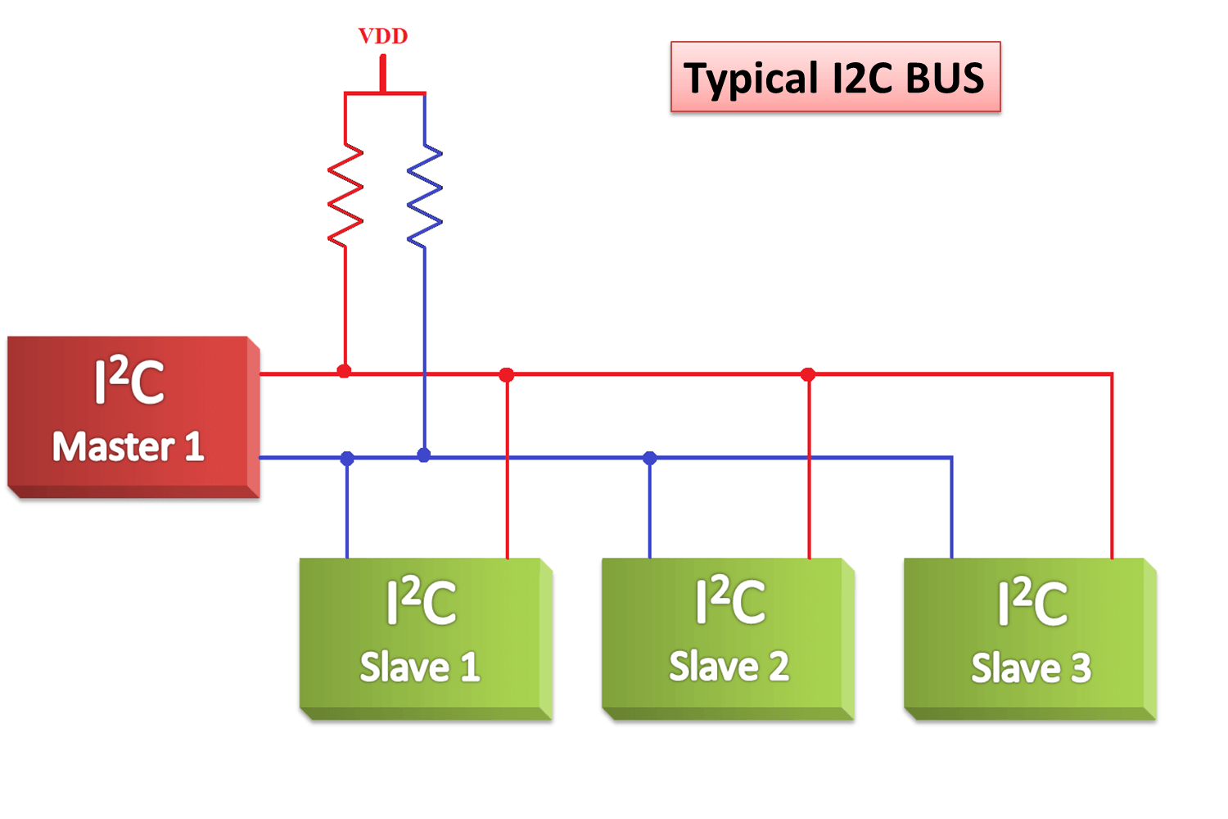

Slide 78
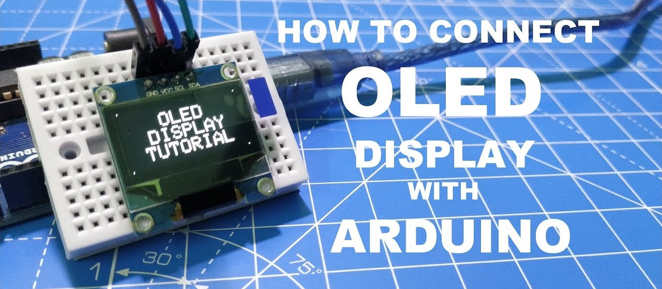
Displays Use I2C

Slide 79
Inter-Integrated Circuit Sound
I2S is a hardware interface designed for audio data transmission, commonly used to connect digital audio devices like microphones, speakers, and codecs.
Transfers audio data with timing signals for precise synchronization between devices.
Supports stereo sound with separate left and right audio channels for high-quality digital audio transmission.
Configurable for different bit depths (e.g., 16-bit, 24-bit) and sampling rates, depending on the quality of audio needed.
I2S is ideal for applications that involve audio input/output, such as wireless audio streaming, sound recording, or interfacing with digital-to-analog converters (DACs) and analog-to-digital converters (ADCs) for audio

Slide 80
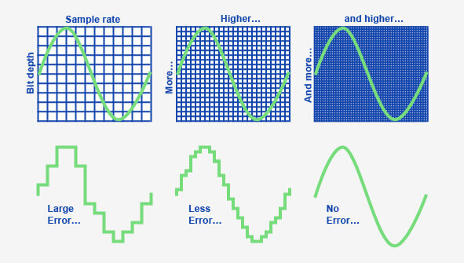

Slide 81
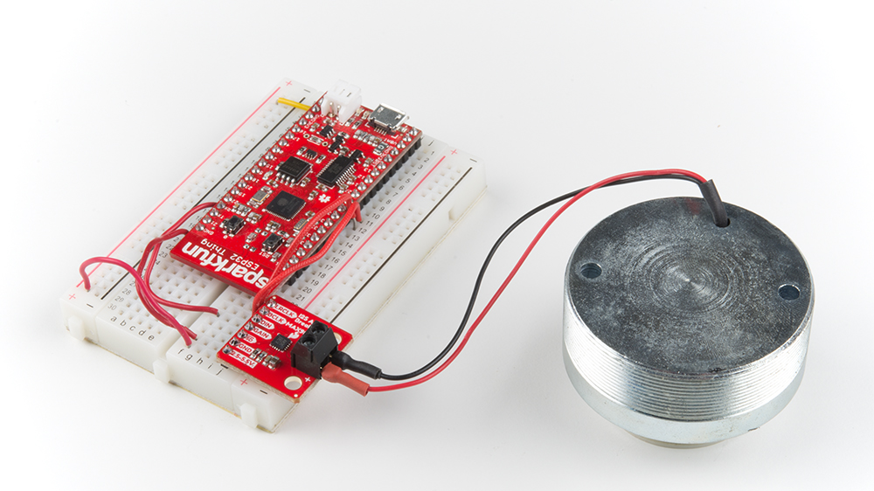
Used for Transducers i.e External DAC Applications

Slide 82
Secure Digital Input Output
SDIO is a peripheral interface that allows communication between the ESP32 and SD cards or other devices like Wi-Fi modules that follow the SDIO standard.
Supports high-speed, low-power communication with SD cards and similar devices, offering up to 4-bit data transfer.
Allows the ESP32 to use SD cards for external data storage, expanding its memory capacity beyond built-in flash.
Provides interrupt-based communication for low-latency control and I/O functionality with SDIO-compliant devices.
In IoT devices, SDIO can be used to store large data logs from sensors or store firmware updates on an SD card, increasing the device’s functionality.

Slide 83
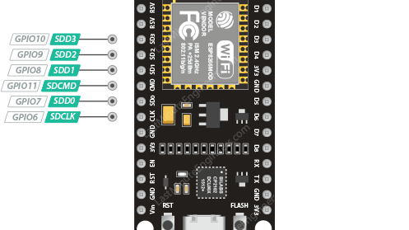
Serial Data Bit 3
Serial Data Bit 2
Serial Data Bit 1
Serial Command
Serial Data Bit 0
Serial Clock

Slide 84
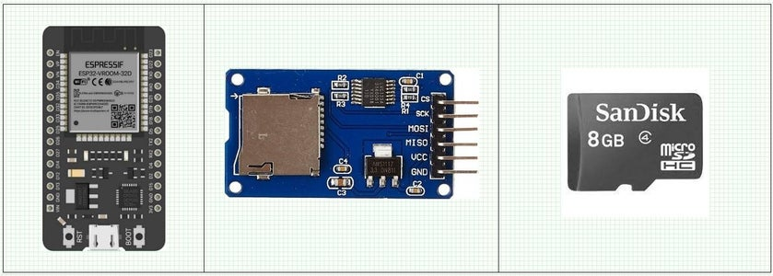
SD Cards
The Most Common Application w/ ESP32 Dev Modules

Slide 85
Universal Asynchronous Receiver/Transmitter)
The UART peripheral provides asynchronous serial communication between the ESP32 and other devices, using a simple, efficient protocol for data transfer.
Asynchronous Communication: No need for a clock signal; devices agree on a baud rate.
Full-Duplex: Supports simultaneous transmission and reception of data.
UART is often used for serial communication with modules like GPS receivers, Bluetooth modules, or for debugging.

Slide 86
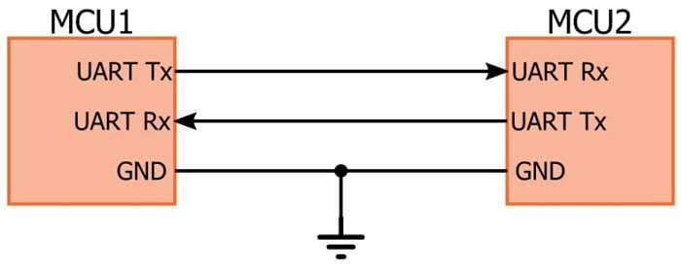

Slide 87
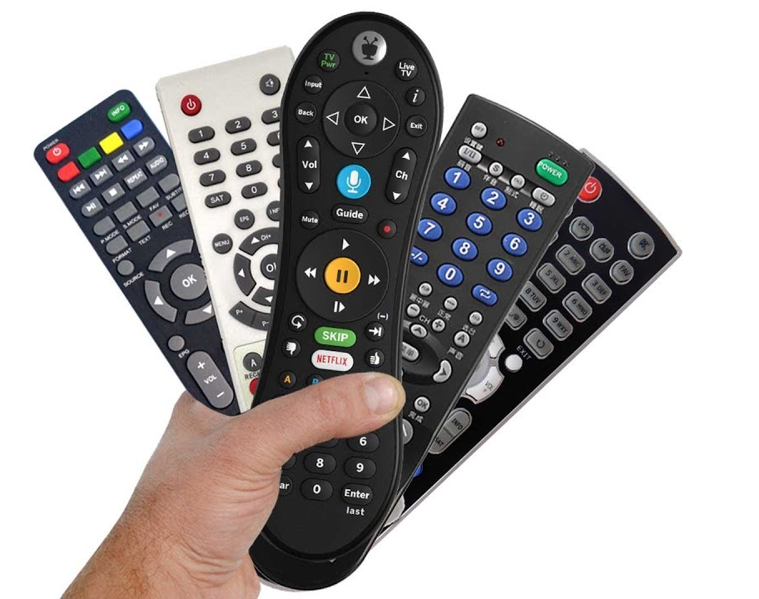
TV Remotes Use UART
Why?
Because it does not require a handshake and data can be sent impromptu

Slide 88
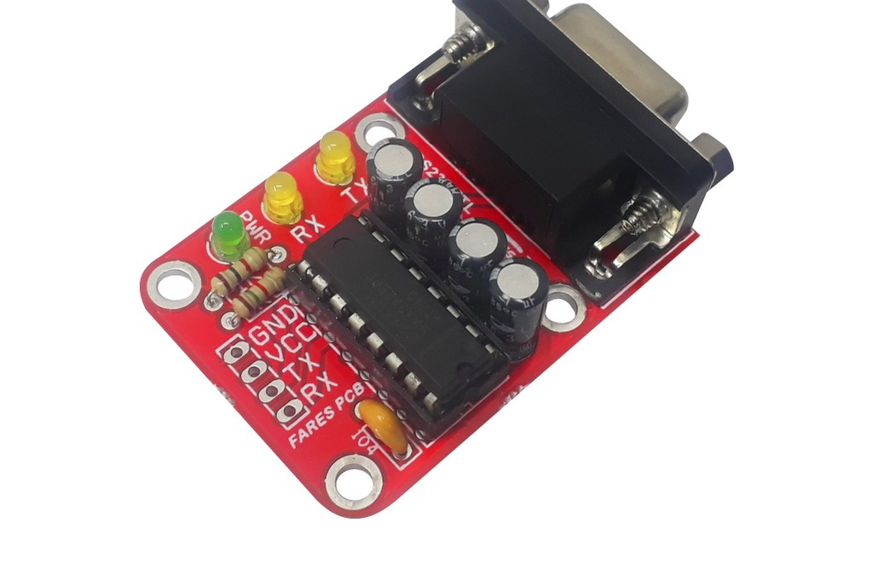
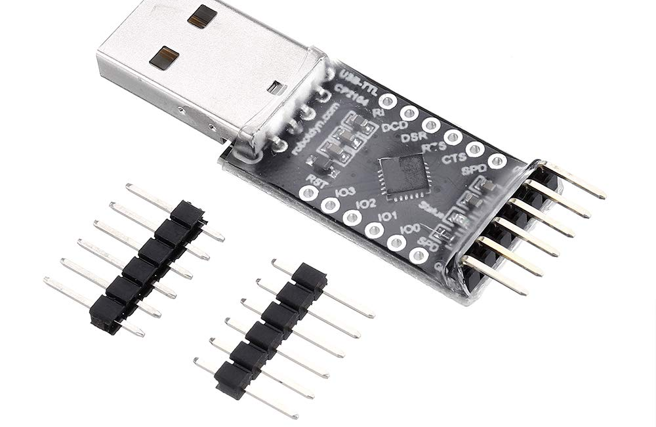
Many of the uC’s Use UART For Programming
So You need UART to Serial Converters
Since Computers Have USB
Universal Serial Bus

Slide 89
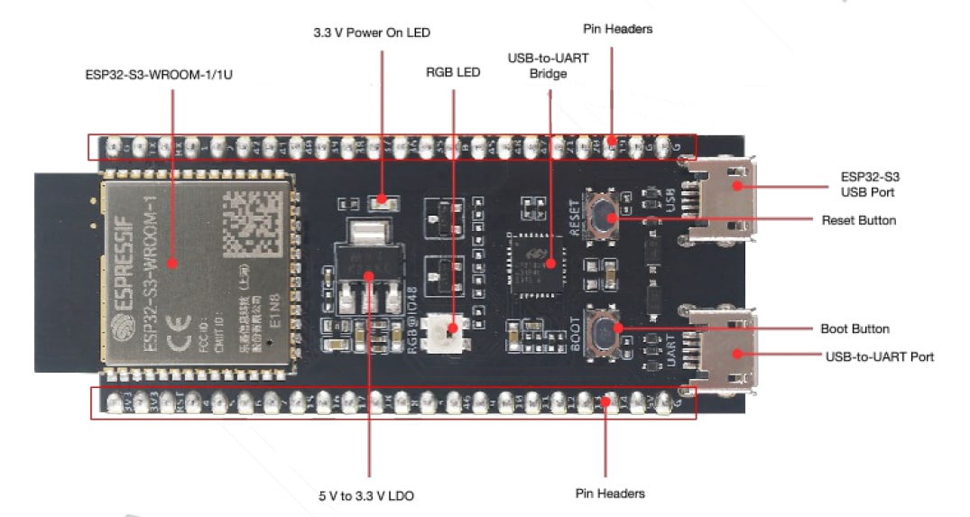
So Why Not Use On Board Serial Devices?
They lack the support for USB Compliance. Exceptions exist

Slide 90
TWAI (Two-Wire Automotive Interface)
TWAI in the ESP32 refers to the CAN (Controller Area Network) interface, which is a multi-master, multi-slave protocol used for communication between microcontrollers and devices in automotive and industrial applications.
Allows multiple devices (nodes) to communicate without a central master, using a two-wire bus for data transmission.
Built for environments with high noise and electrical interference, common in automotive and industrial setups.
Messages are assigned priorities, and the bus arbitration ensures that higher priority messages are sent first, ideal for critical real-time communication.
TWAI/CAN is used in automotive networks (e.g., for engine control, airbags, ABS) and industrial automation systems. An ESP32 could be integrated into a vehicle diagnostic system, communicating with other electronic control units (ECUs) over the CAN bus.

Slide 91
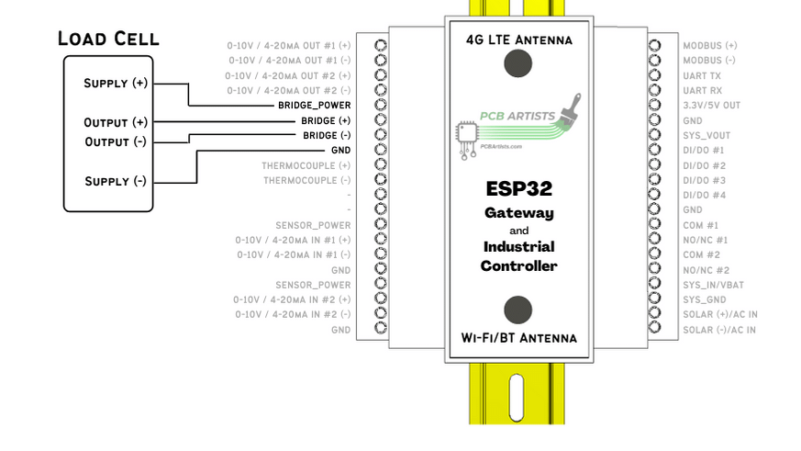

Slide 92
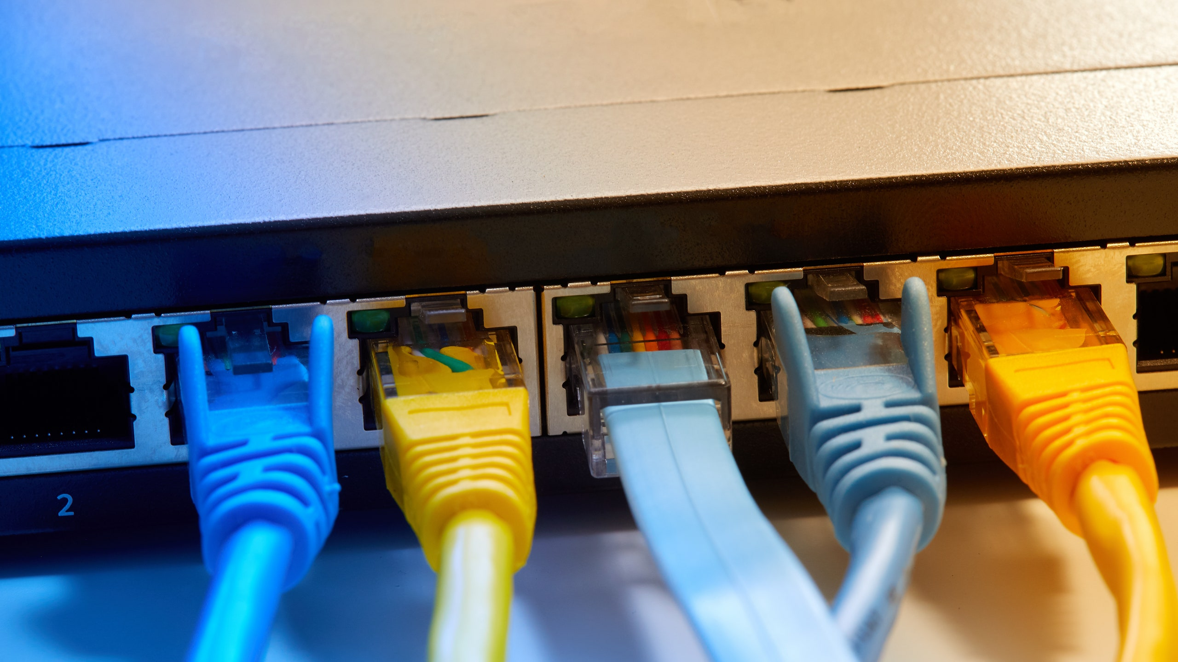
How to Have a Stable Internet Connection

Slide 93
Ethernet
Ethernet is a wired communication protocol offering high-speed, reliable data transfer between the ESP32 and networked devices.
Ethernet supports higher data rates, offering stable and low-latency communication.
Provides a physical, secure connection to a network, reducing interference and ensuring reliable communication in industrial settings.
Commonly used in environments requiring robust data communication, where wireless connections might fail due to interference or security concerns.
Ethernet is used for projects that need continuous, stable connectivity, like local servers, IoT hubs, or industrial machines that require low-latency data transfer.

Slide 94
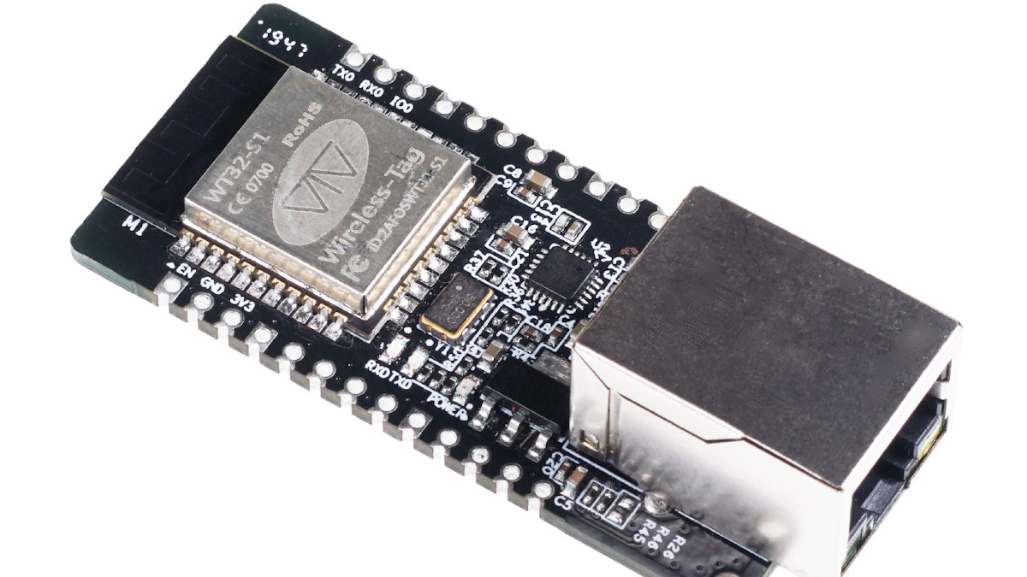

Slide 95
Remote Control Transmitter/Reciever
RMT is a hardware peripheral in the ESP32 designed for precise pulse-based communication, such as infrared (IR) signal transmission or decoding and custom remote control protocols.
The RMT peripheral generates or decodes pulses with precise timing, essential for remote control protocols.
This is a hardware-driven interface, freeing up the CPU while ensuring reliable performance.
RMT can handle a wide range of protocols, including NEC for IR signals, as well as custom protocols for motor control or pulse-based sensors.
RMT is often used for infrared remotes, signal decoding, and pulse width modulation in smart devices. Use RMT to control home appliances via an IR remote or decode sensor signals that use pulse modulation.

Slide 96
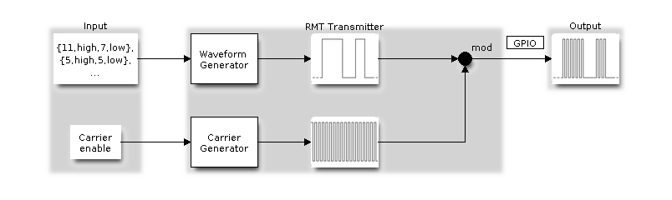
RMT can use UART for IR Communication

Slide 97
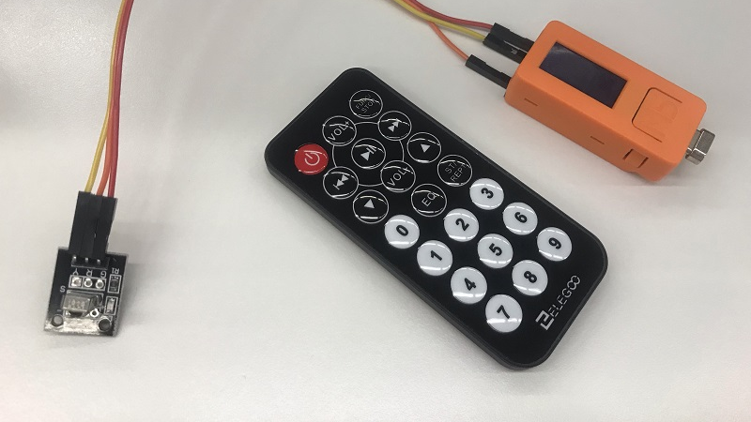

Slide 98
Pulse Width Modulation
PWM is a method of generating analog-like signals by rapidly switching a digital signal between on and off states. It's used to control the power delivered to devices or generate precise control signals.
The duty cycle (percentage of time the signal is high) can be adjusted to control devices like LEDs, motors, and actuators.
PWM can also be used to generate signals for devices like servo motors, which require specific pulse widths to determine their position.
Provides efficient power control since the energy is switched on and off rapidly with minimal heat generation.
Controlling LED brightness or DC motor speed by adjusting power levels. Generating servo signals, where a specific pulse width (e.g., 1ms to 2ms) moves the servo to a certain angle in robotics applications.

Slide 99
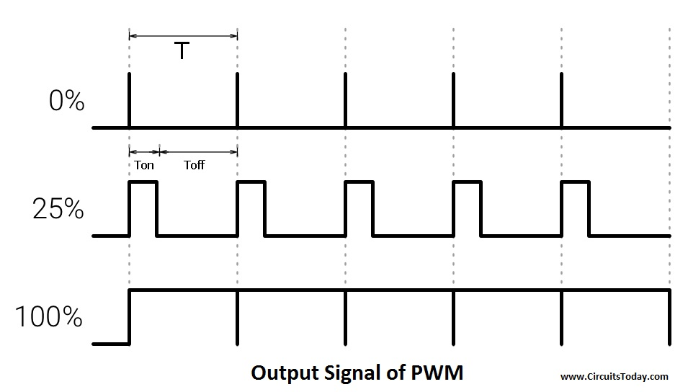
It is Literally The Width of the Square Wave High Time

Slide 100
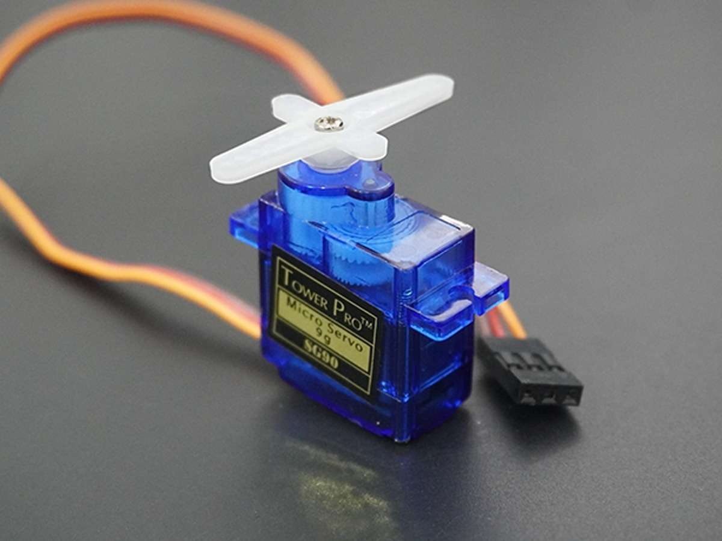

PWM Signal and Power Applications

Slide 101
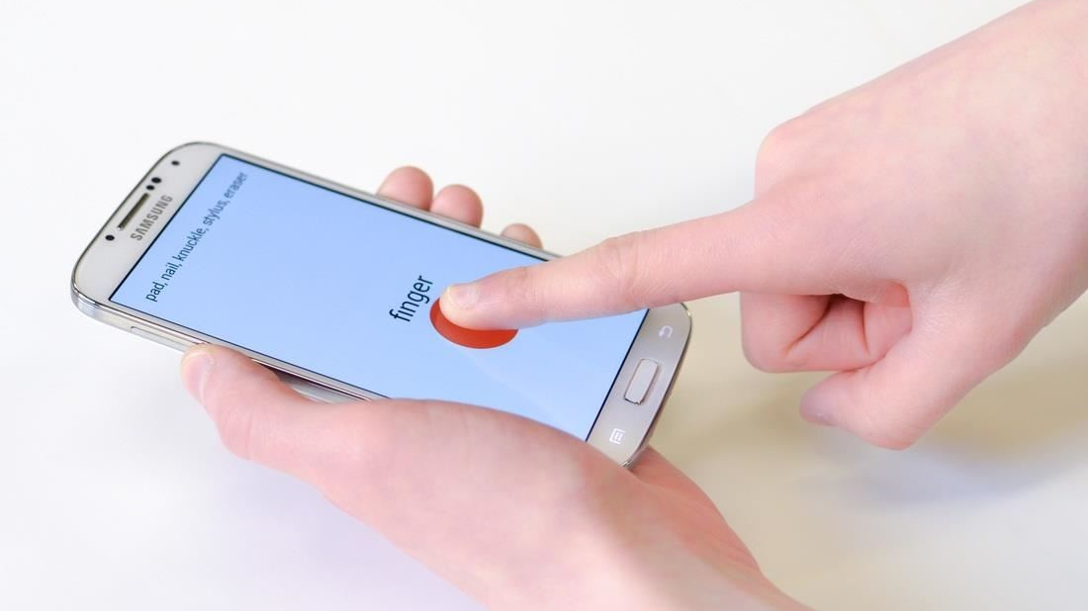
More Input Options

Slide 102
Touch Sensing
The ESP32 has a built-in capacitive touch sensor system that allows touch input detection without mechanical buttons.
Detects changes in capacitance when a human finger (or conductive object) approaches a sensor pad.
Supports up to 10 touch channels, allowing multiple touchpoints to be monitored simultaneously.
Since touch sensors have no moving parts, they are highly durable and do not degrade over time like physical buttons.
Touch sensors are commonly used for creating touch-based user interfaces, such as in smart home control panels, touchpads, or gesture-based control systems. An ESP32 touch sensor could be used to control light dimming or appliance control by detecting finger touches on a wall-mounted touchpad.

Slide 103
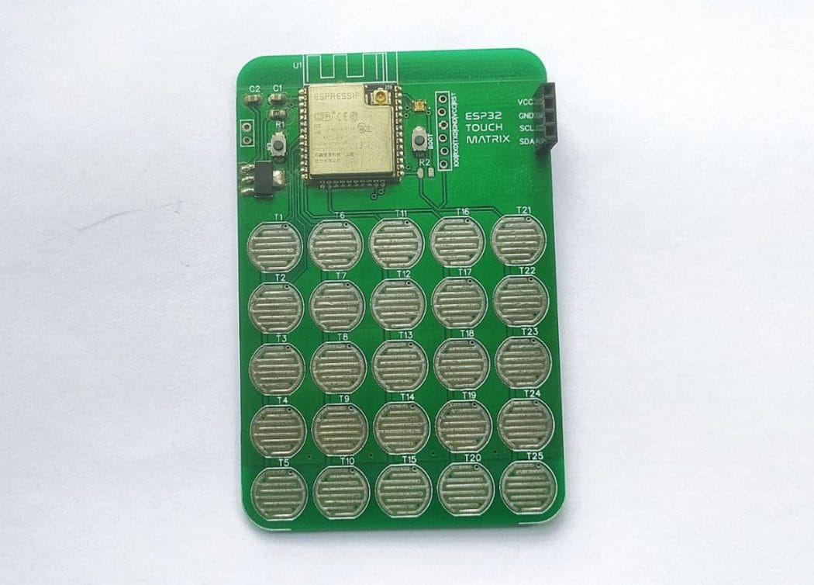
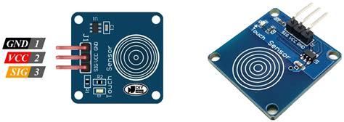
Touch Modules

Slide 104
Digital to Analog Converter
The ESP32 has two 8-bit DAC channels for converting digital values into analog voltage signals.
Each DAC channel has a resolution of 8 bits, meaning it can output 256 discrete levels of voltage, ranging from 0V to the reference voltage (typically 3.3V).
The ESP32 has two DAC channels, which can be used for applications like stereo audio generation or controlling multiple analog devices independently.
The DACs can be used to generate sound waves, control analog actuators, or create smooth analog outputs from digital data.
DAC1 (GPIO25) and DAC2 (GPIO26) allow the ESP32 to generate analog signals for audio applications, waveform generation, or driving devices that require an analog control signal.

Slide 105
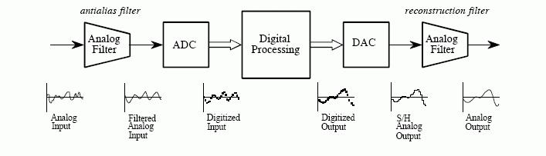
To and Fro Conversion Diagram

Slide 106
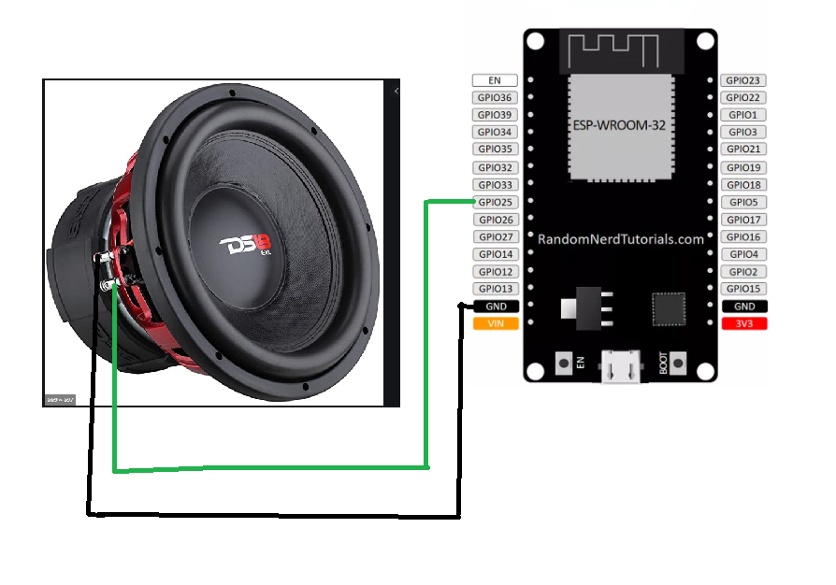
Used to Generate an AC or DC Voltage

Slide 107
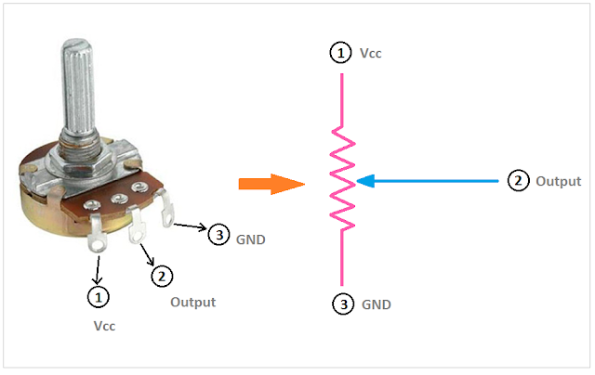
Even Digital Potentiometers Can be Made
Just Remember the Output has a DC Offset
Which means a DC Blocking Capacitor is Needed for true AC Voltage Generation

Slide 108
Analog to Digital Conversion
The ESP32 has multiple 12-bit ADC channels that convert analog voltages into digital values for processing. Each ADC has a resolution of 12 bits, providing 4096 discrete levels to represent the input voltage. This allows for more precise measurements compared to lower bit-depth ADCs.
The ESP32 has 18 ADC channels, spread across two ADC units (ADC1 and ADC2). These channels are mapped to different GPIO pins.
The ADC supports a voltage input range from 0V to 1.1V with an attenuation of 0dB though the Arduino IDE sets it to 11dB to allow up to 3.3 while ESP Home does Not, making it suitable for reading sensor values like temperature, light, and humidity.
ADC1 Channels:GPIO32 to GPIO39 (8 channels)
ADC2 Channels:GPIO0, GPIO2, GPIO4, GPIO12 to GPIO15, GPIO25 to GPIO27 (10 channels)
ADC1 is commonly used when you want to measure analog inputs while keeping Wi-Fi enabled, as ADC2 cannot be used when Wi-Fi is active.

Slide 109
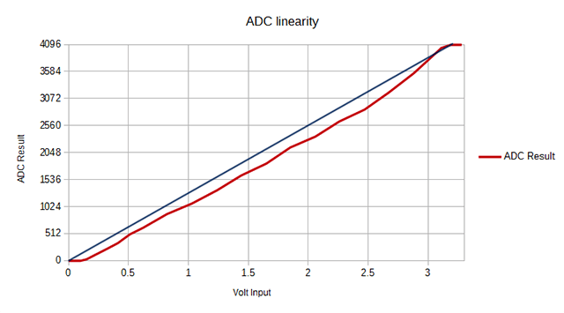

Slide 110
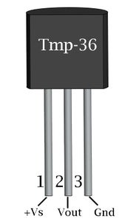
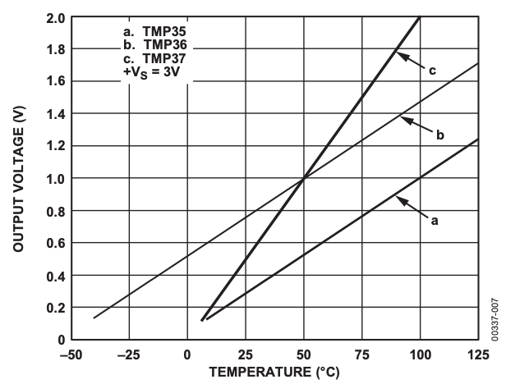
Analog Sensor Interfacing

Slide 111
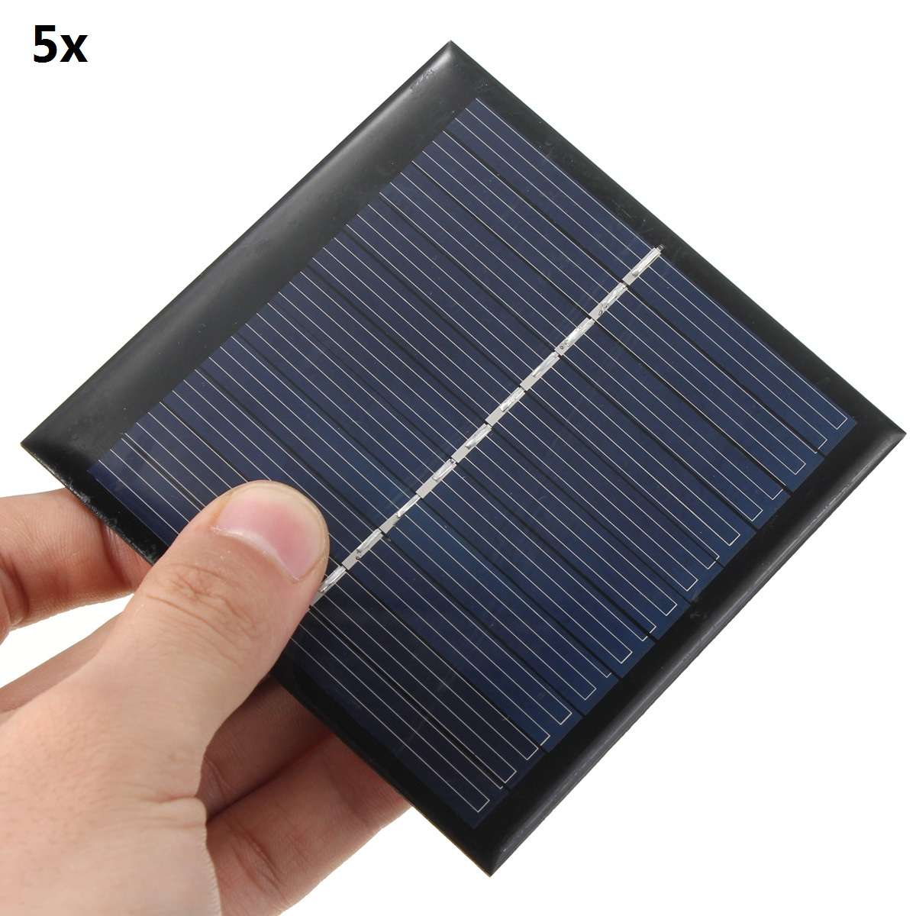

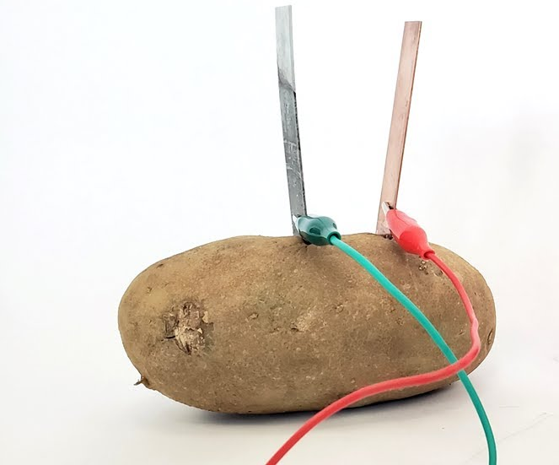
ANY THING

Slide 112

You can Measure Any Voltage

Slide 113


Slide 114
Timers
The ESP32 includes a variety of timers that provide precise control over time-dependent operations such as delays, event scheduling, and time-sensitive tasks.
Types of Timers in ESP32:
The ESP32 has four 64-bit general-purpose timers, each divided into two 32-bit parts, making it ideal for handling tasks that need precise timing or scheduling.
Each timer has a 64-bit counter, allowing for extremely high-precision timekeeping. The clock source can be configured to run at different frequencies.
Each of the four timers is independent, meaning you can use them for different tasks, such as delays, pulse generation, or event scheduling.
The timers can automatically reload their values after reaching a predefined limit, perfect for periodic tasks such as sensor polling or PWM signal generation.
Timers can trigger interrupts when they overflow or hit specific time values, enabling tasks like toggling GPIO pins or triggering other functions.
A timer can be set to trigger an interrupt every 1ms, allowing for precise control over periodic tasks like sensor sampling or generating waveforms for communication protocols.

Slide 115

The Watcher

Slide 116


Slide 117


Slide 118
The Watchdog
Watchdog Timers are used to reset the system if a program gets stuck or takes too long to execute, preventing it from getting stuck in an infinite loop or deadlock.
If the system does not reset the watchdog timer within the specified timeout period, it triggers a system reset to recover from failures.
The ESP32 has both software and hardware watchdog timers to ensure system reliability.
In a Wi-Fi-enabled device, a watchdog timer can be used to reset the ESP32 if it loses connection or fails to execute network tasks within the set timeout.
Timers provide accurate control over time-related tasks like signal generation, delays, and event scheduling.
They allow time-based actions without blocking the main program, useful for tasks like non-blocking delays and real-time event handling.

Slide 119
We Truly Have Only Scratched the Surface
Model | Cores | Clock Speed | Flash | RAM (SRAM) | Wireless | Peripherals | Notable Features
ESP8266 | 1 (Tensilica L106) | 80 MHz / 160 MHz | 512 KB - 4 MB | 80 KB (user) | Wi-Fi 802.11 b/g/n | UART, SPI, I2C, ADC (1 ch), PWM | Low power, No Bluetooth
ESP32 (WROOM-32) | 2 (Xtensa LX6) | 160 MHz / 240 MHz | 4 MB - 16 MB | 520 KB | Wi-Fi 802.11 b/g/n, Bluetooth 4.2 (BR/EDR + BLE) | UART, SPI, I2C, I2S, ADC (18 ch), DAC, PWM | Dual-core, Bluetooth, Ultra Low Power (ULP), ADC attenuation up to 3.3V
ESP32-S2 | 1 (Xtensa LX7) | 240 MHz | 4 MB - 16 MB | 320 KB | Wi-Fi 802.11 b/g/n | UART, SPI, I2C, ADC (20 ch), DAC, USB OTG | USB OTG support, single-core, secure boot
ESP32-S3 | 2 (Xtensa LX7) | 240 MHz | 4 MB - 16 MB | 512 KB + 8 MB PSRAM | Wi-Fi 802.11 b/g/n, Bluetooth 5 (LE) | UART, SPI, I2C, I2S, ADC (20 ch), DAC, USB OTG | Enhanced BLE, vector extensions for AI processing, larger RAM
ESP32-C3 | 1 (RISC-V) | 160 MHz | 4 MB | 400 KB | Wi-Fi 802.11 b/g/n, Bluetooth 5 (LE) | UART, SPI, I2C, ADC (6 ch), PWM | RISC-V architecture, compact, Bluetooth 5, low power consumption
ESP32-C6 | 1 (RISC-V) | 160 MHz | 4 MB | 400 KB | Wi-Fi 6 (802.11ax), Bluetooth 5 (LE) | UART, SPI, I2C, ADC, GPIO, Ethernet | Wi-Fi 6 support, BLE 5 long-range, secure boot
ESP32-H2 | 1 (RISC-V) | 96 MHz | Up to 4 MB | 256 KB | IEEE 802.15.4 (Thread and Zigbee), Bluetooth 5 (LE) | UART, SPI, I2C, GPIO | Thread/Zigbee integration, ultra-low power, RISC-V

Slide 120

The End

